Slide 1
WEEK 5 Tree Algorithms

Slide 2
Decision Tree
New Data
Does it have wheels ?
Yes
No
Does it have 4 wheels ?
Not Car
Yes
No
Car
Not Car

Slide 3
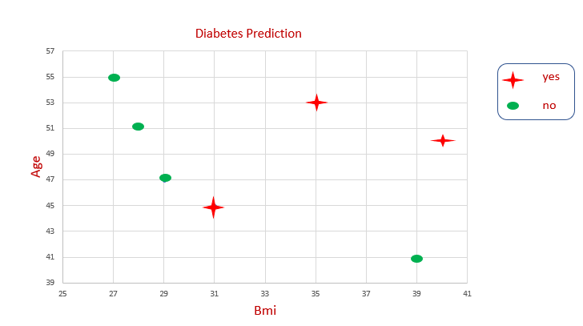
New Data
Bmi >= 30
Yes
No
Age >= 43
Not Diabetes
Yes
No
Diabetes
Not Diabetes

Slide 4
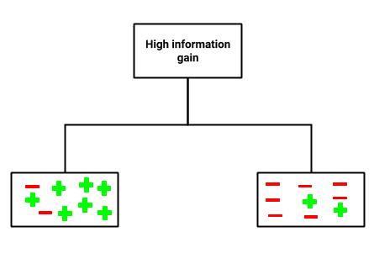
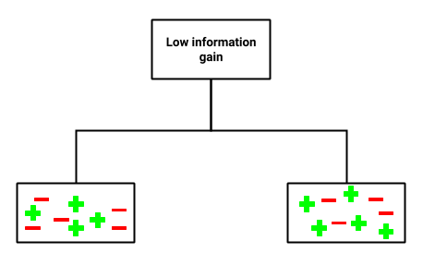
How does a Decision Tree Learn ?

Slide 5
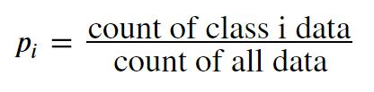
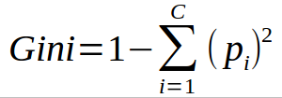
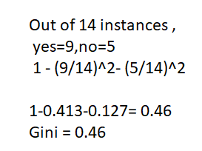
Gini index

Slide 6
3 data points:
yes=0, no=3
Gini = 1 –(0/3)^2 - (3/3)^2
= 1 – 0 – 1
= 0
4 data points:
yes=3, no=1
Gini = 1 –(3/4)^2 - (1/4)^2
= 1 – 0.5625 – 0.0625
= 0.375
Weighted Final Gini index
Gini index = (3/7) * 0 + (4/7) * 0.375
= 0.214

Slide 7
4 data points:
yes=1, no=3
Gini = 1 –(1/4)^2 - (3/4)^2
= 1 – 0.0625 – 0.5625
= 0.375
3 data points:
yes=2, no=1
Gini = 1 –(2/3)^2 - (1/3)^2
= 1 – 0.444 – 0.111
= 0.444
Weighted Final Gini index
Gini index = (4/7) * 0.375 + (3/7) * 0.444
= 0.404

Slide 8
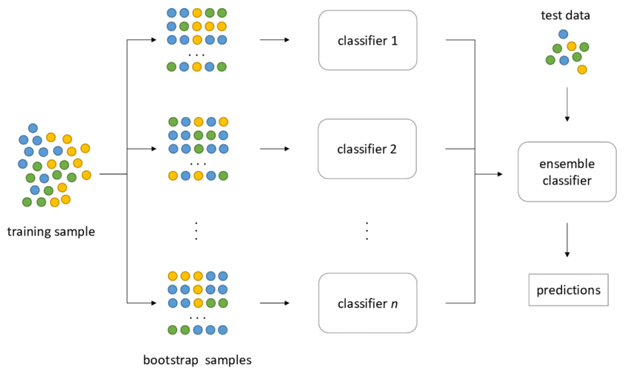
Bagging
Ensembling trees trained with random samples

Slide 9
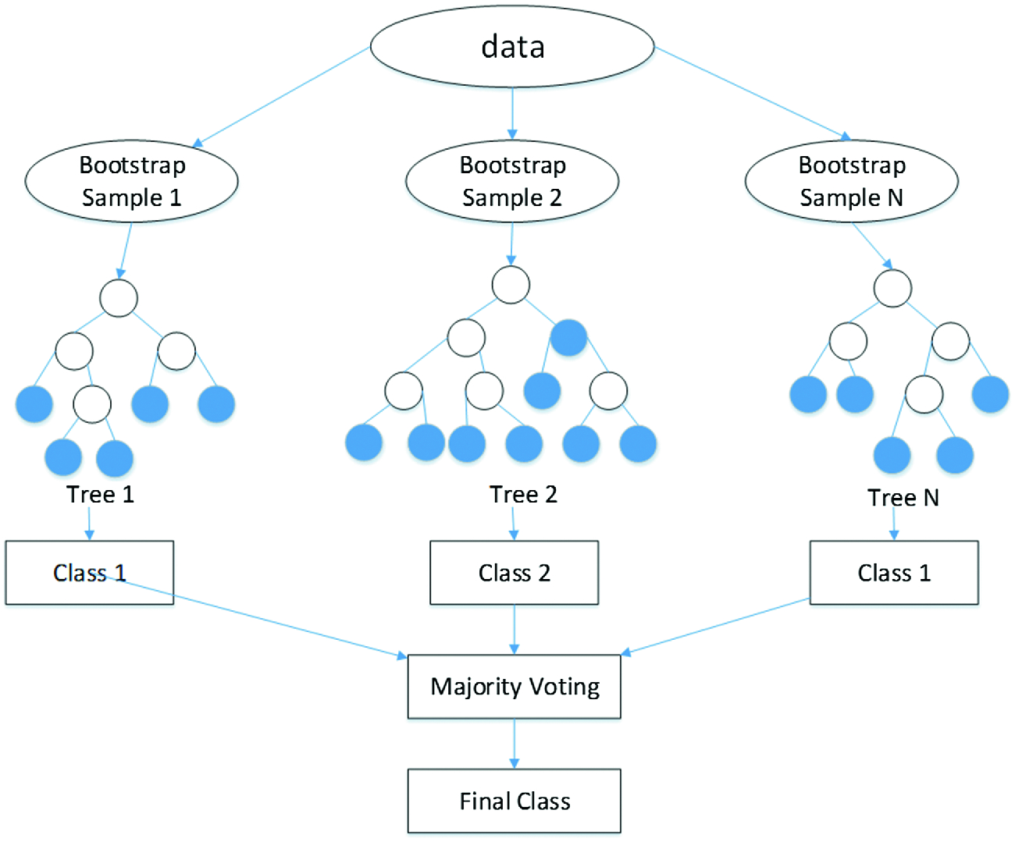
Random Forest
Ensembling trees trained with random samples and random features

Slide 10
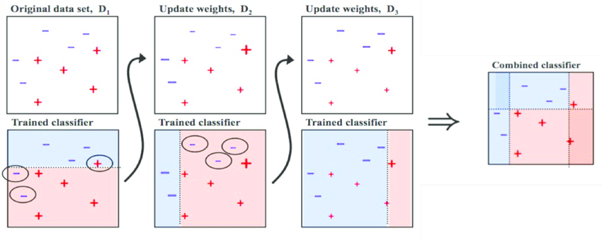
Boosting

Slide 11
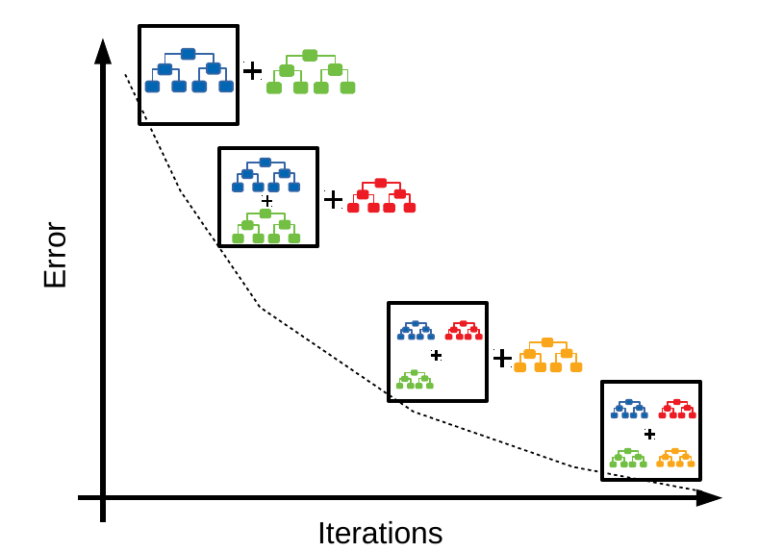
Gradient Boosting

